Slide 1
Tutorial 1 Learning Topology Optimization Through Examples and Case Studies
August 18, 2019

Slide 2
Modeling for Topology Optimization

Slide 3
Modeling
Real design problem →TopOpt Problem
Geometry (design space)
Material
Loads and restraints
Simulation parameters
Constraints

Slide 4
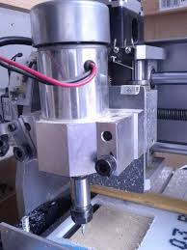
Spindle Mount

Slide 5
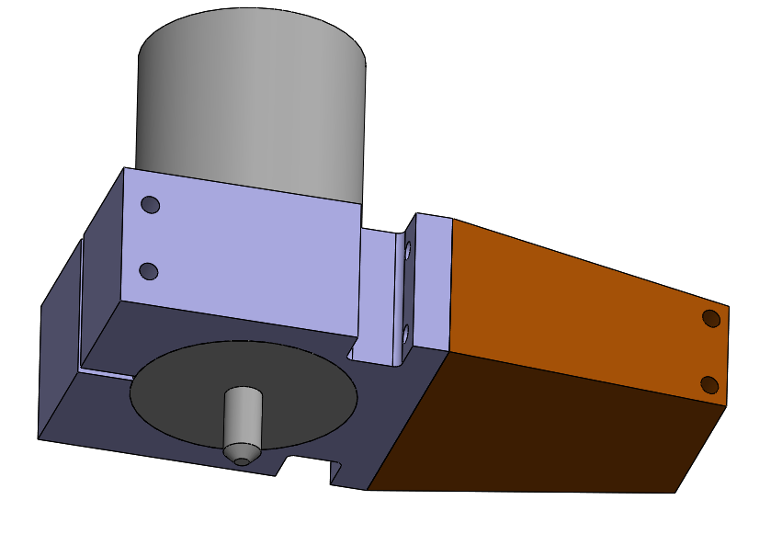
Spindle Mount
Spindle
Spindle mount
Spindle clamp
Optimize the topology of spindle mount

Slide 6
Spindle Mount
Sliding
1300 lb-in
Fixed
500 lb

Slide 7
Spindle Mount (Load 2)
Sliding
3900 lb-in
Fixed
250 lb

Slide 8
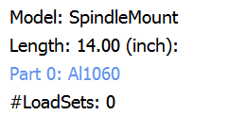
Questions?
Design space?
Mountings?
Material?

Slide 9
Loads?

Slide 10
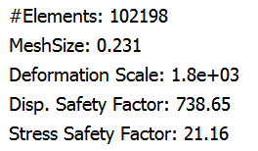
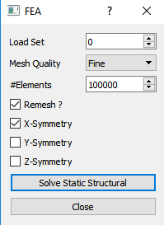
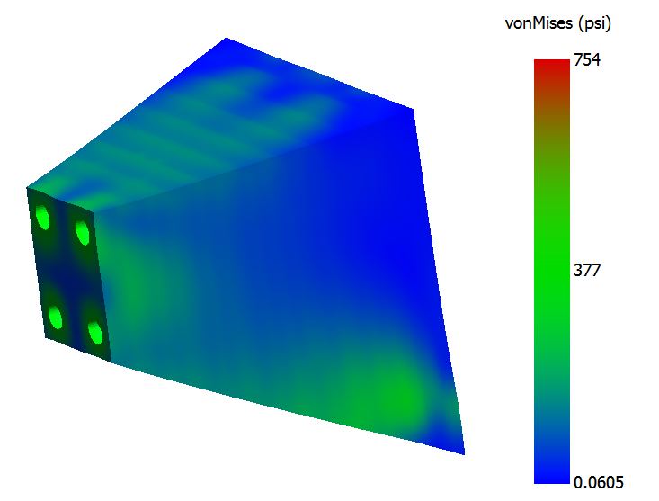
FEA

Slide 11
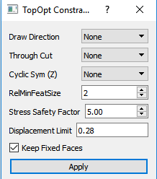
Optimization Parameters
Target safety factor of 5.0
Keep fixed faces

Slide 12
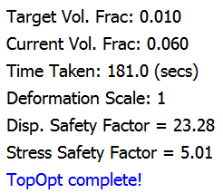
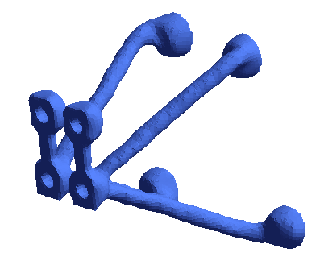
Optimization Result

Slide 13
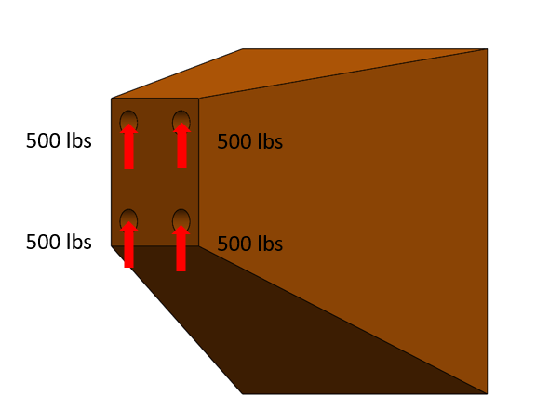
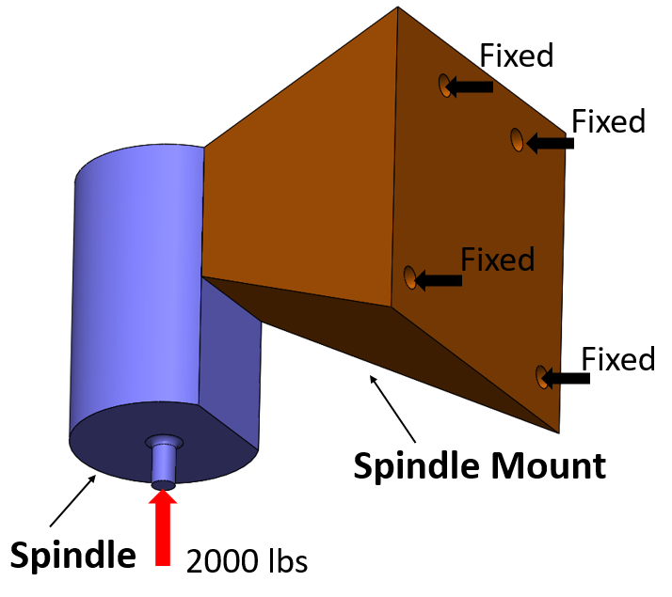
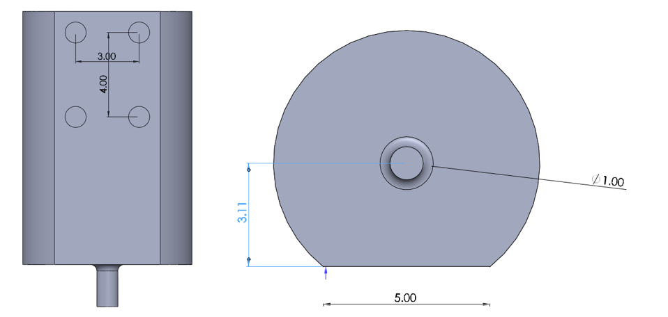
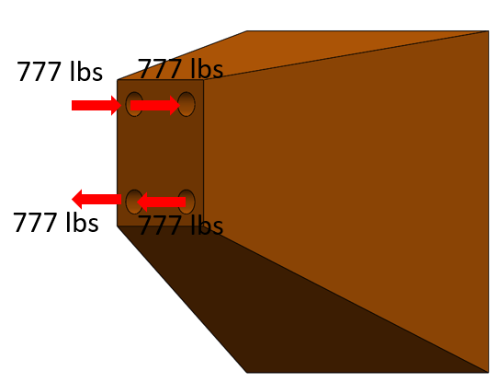
Loads?

Slide 14
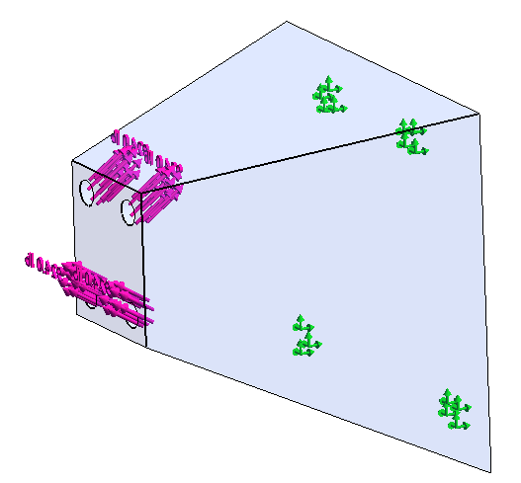
Combined loading

Slide 15
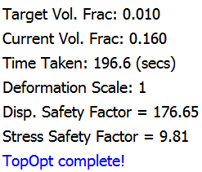
Optimization Result

Slide 16
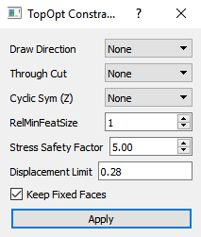
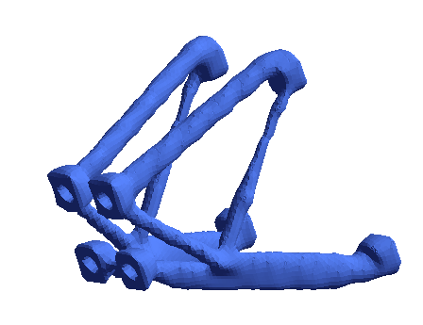
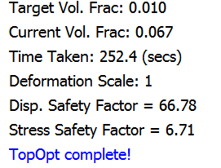
Optimization Parameters
Smoothening to 1.0

Slide 17
Compare
Without moment
With moment

Slide 18
Spindle Mount
Sliding
1300 lb-in
Fixed
500 lb

Slide 19
Spindle Mount
Sliding
1300 lb-in
Fixed
300 lb
500 lb

